Slide 1
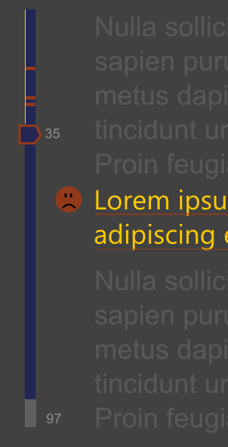
Yellow indicates that the line has been reviewed.
Number of the current script line.
Orange stripe for needs attention (failed review).
Lines that have a review indicate with a face
Thumb color indicates status of current line.
Negative review earns a orange underline
Blue means there is a recording
Total number of script lines in this chapter.
This color means there is xlation (future version could conceivably show another color where xlation is missing)

